Slide 1

Application: StayMatch Type: Application Architecture View: Logical View Style: Layered Architecture Pattern
Users
Delivery Channels
Core Business Processes
Data And Information
Technology Enablers
Register Renter
Renter data
NoSQL Database (MongoDB)
Renters
Register Owner
Owner data
Location API
Browsers
Post property
Search information
Backend REST APIs (Python)
Search property
Property data
User Interface (React)
Wishlist property
Property wishlist data
Owners
Application Hosting Server (AWS Elastic)
Rate or review property
Property review data
Github & Delivery Pipeline
Contact Owner
Owner Contact data

Slide 2
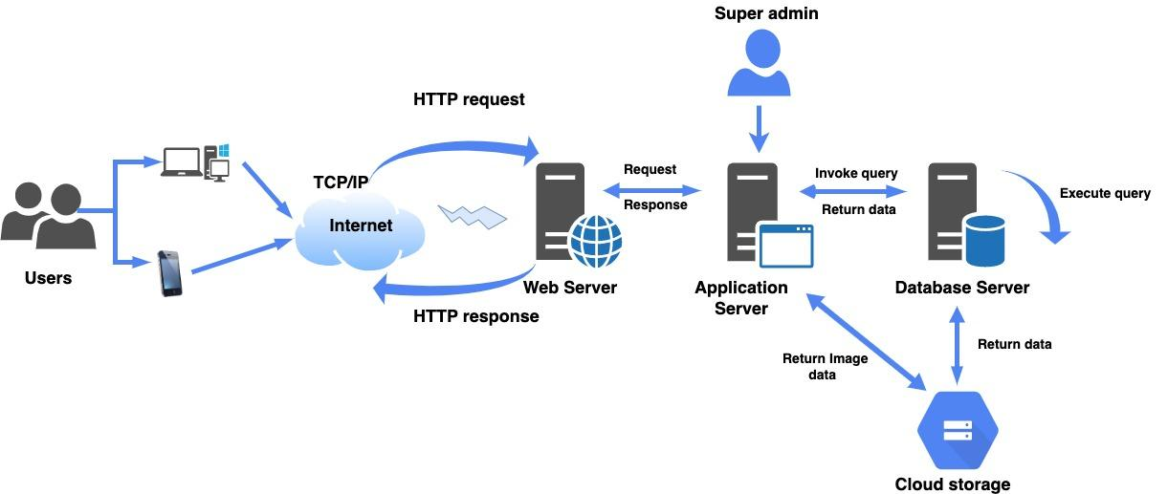
Application: StayMatch Type: Application Architecture View: Process View Style: Client-Server Pattern

Slide 3
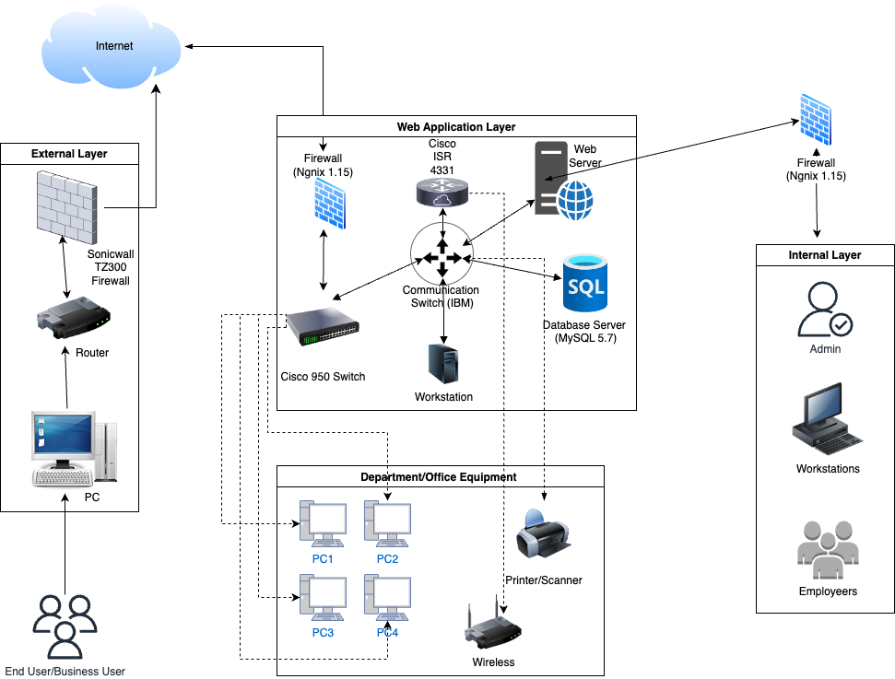
Application: StayMatch Type: Application Architecture View: Physical View Style: Layered Architecture Pattern

